Slide 1
Transitional disk system of HD 135344B
A-Ran Lyo
KASI (Korea Astronomy and Space Science Institute)
Nagayoshi Ohashi, Charlie Qi, David J. Wilner, and Yu-Nung Su

Slide 2
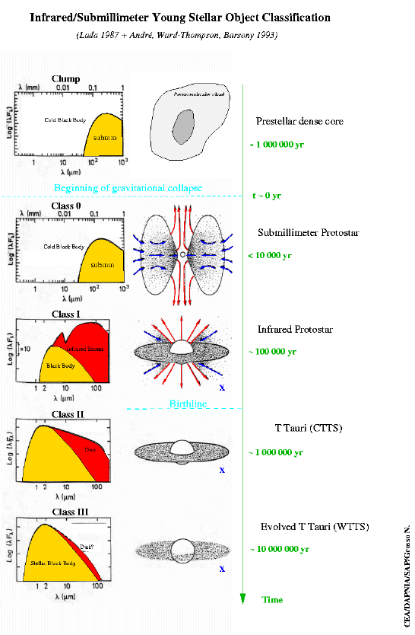

Slide 3
1. Circumstellar disks are ubiquitous
Hillenbrand 2003

Slide 4
2. Planet systems are ubiquitous ?
FGK stars : 10% harbors an giant planet with a period P<2000 days
Careful extrapolation to larger semimajor axes indicates that ~<20% of
stars harbor a giant planet within 20AU
(Marcy et al. 2005, Butler et al. 2006, Cumming et al. 2008)

Slide 5
3. Transitional disk system : significant disk evolution
(possible site for the current planet formation within the disk)
3.1. Long-lived disk system
Hillenbrand 2003

Slide 6
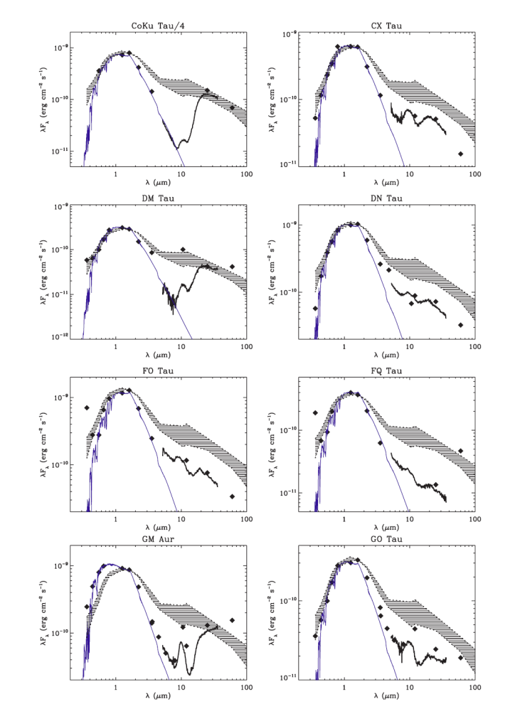
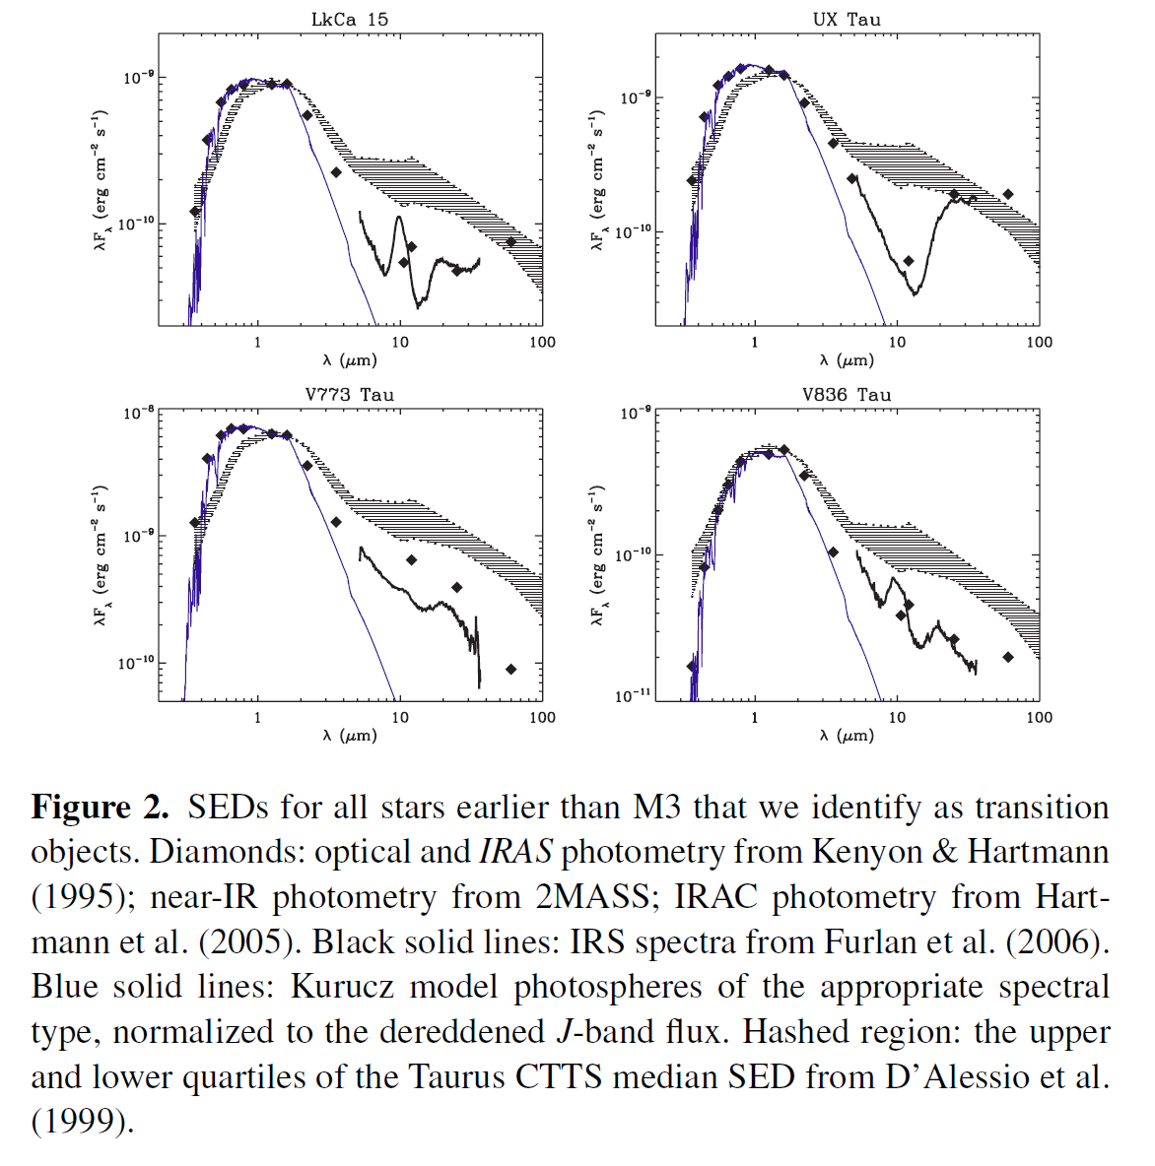
3.2. inner gap/hole ?
SED : optically thin inner disk surrounded by an optically thick outer disk
Lower accretion rates & larger disk mass
Najita, Strom, & Muzerolle 2007

Slide 7
4. Transitional disk system : HD 135344B
Star
α = 15:15:48.4 , δ =-37:09:16.8
Sp = F4 V or F8V (Dunkin et al. 1997a,b)
M = 1.8 M_{ʘ}
Age = 8 Myr
Mass accretion rate = 10^{-8.27} M_{ʘ}/year (Garcia Lopez et al. 2006)
d = 140 pc (van Boekel et al. 2005)
Disk
0.8 mm = 570±21 mJy
1.3 mm = 142±19 mJy (Sylvester et al. 1996)

Slide 8
4.1. Spectral Energy Distribution (SED) : Gap ?
Spectral type F4
Total Av along line-of-sight 0.5 mag
Distance 84 pc
Stellar mass 1.8 M_{ʘ}
Stellar radius
Stellar temperature 6600 K
Stellar luminosity 6.8 L_{ʘ}
Inner dust rim (R_{Disk,in}) 0.18 AU
Inner radius of gap (R_{Gap,in}) 0.45 AU
Outer radius of gap (R_{Gap,out}) 45 AU
Dust mass of grain size range
from 0.01 to 10 μm (M_{Dust,small}) 5×10⁻⁶ M_{ʘ}
Disk inclination 10°
M_{inner} 0.10 M_{lunar}
Surface height of disk (Hp (R_{disk})/R_{disk})
0.13
Brown et al. 2007

Slide 9
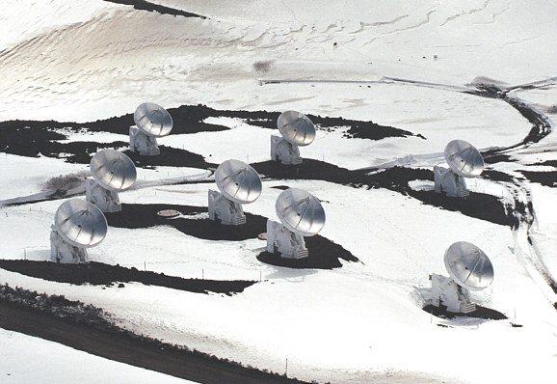
4.2. High-resolution direct imaging (SMA)
Submillimeter Array (SMA)
8, 6-m radio telescopes
230 GHz-bands (4 tracks)
: 1.3 mm continuum
¹²CO (J=2-1)
¹³CO (J=2-1)
C¹⁸O (J=2-1)

Slide 10
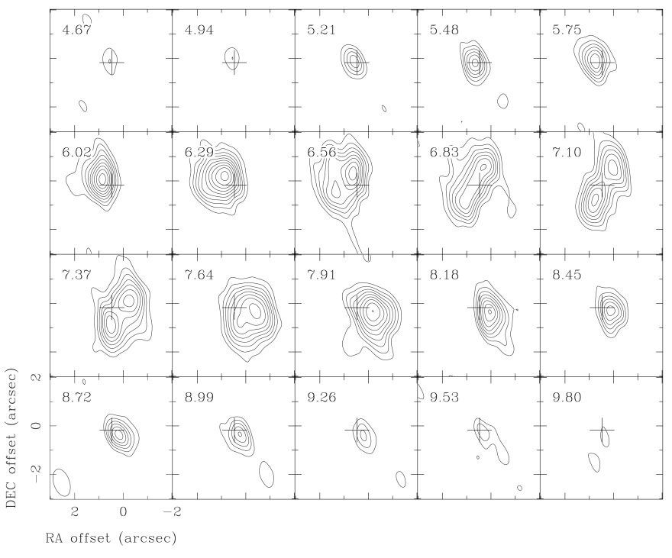
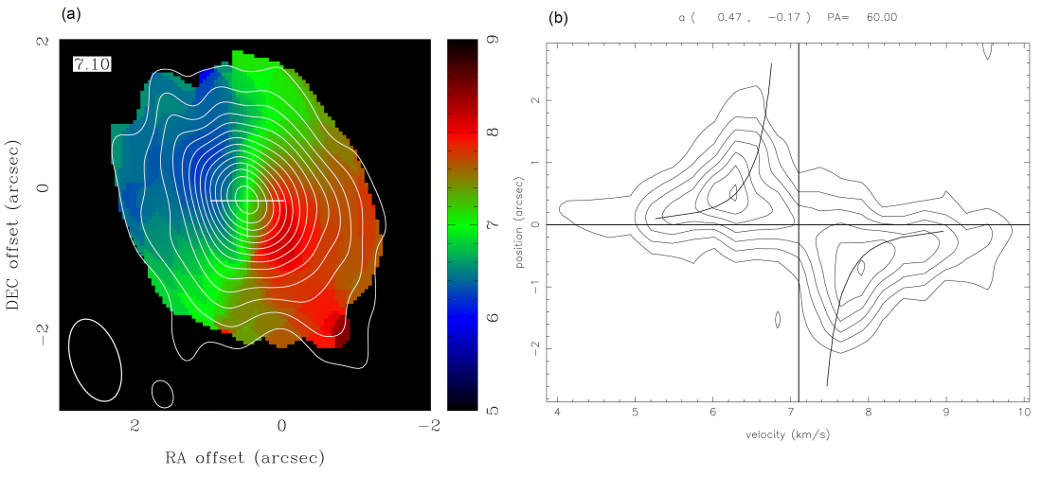
4.2.1. CO molecular line emission
Geometry, kinematics, and properties of the gas disk
FWHM = 1.16”×0.65” (all tracks)
Kelper rotation
i = 10° & PA = 60°
Tg ~ 30K
disk mass ~ 3.8×10⁻⁴M_{ʘ}

Slide 11
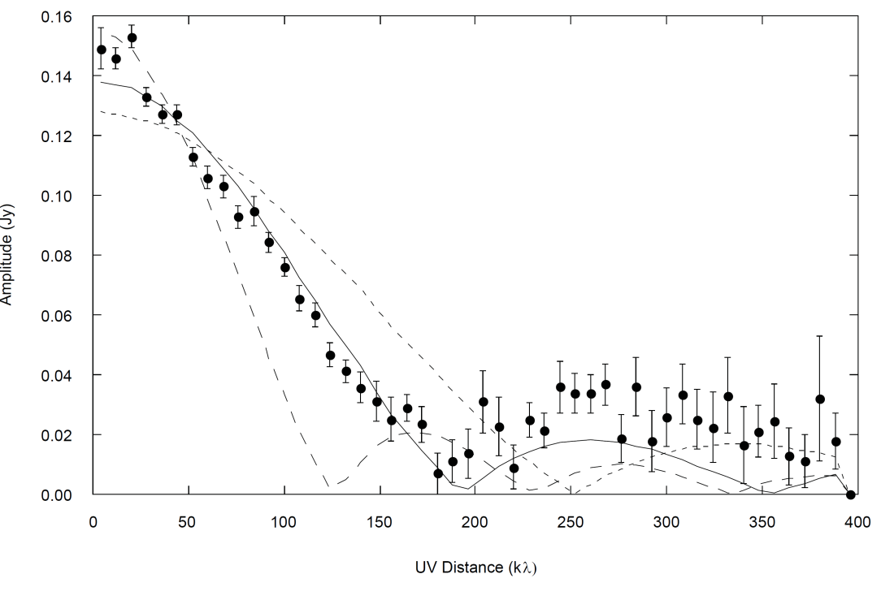
4.2.2. 230 GHz Continuum emission
Disk structure and properties
Disk size = 180-200 AU
(at d=140 pc)
Disk mass ~ 2.8×10⁻²M_{ʘ}
(total flux density 141 mJy)

Slide 12
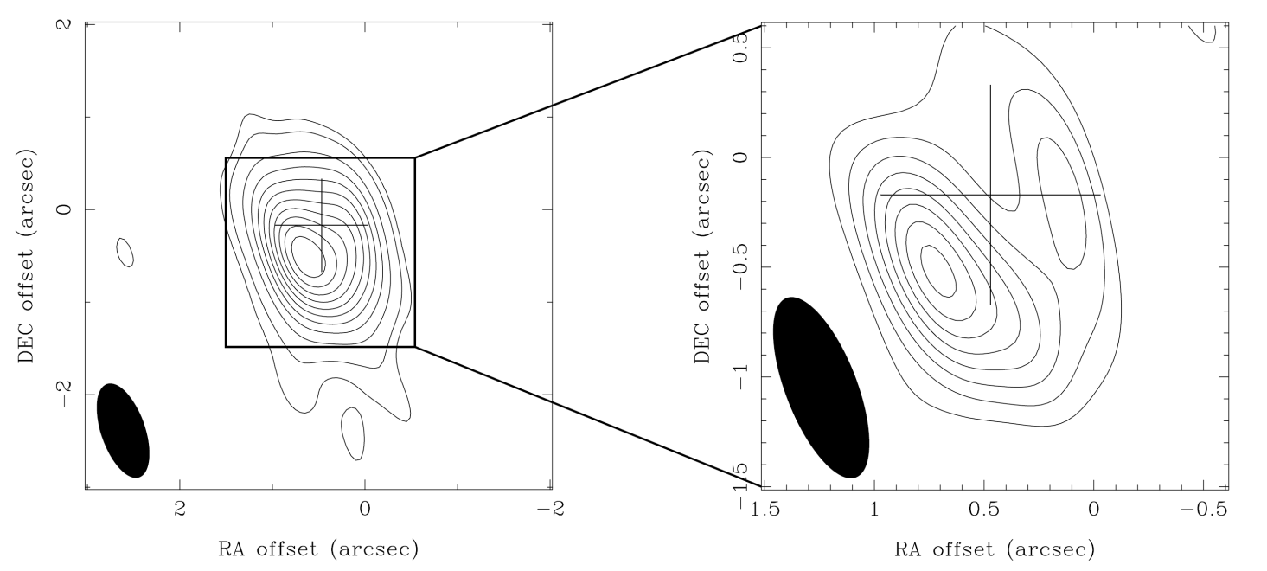
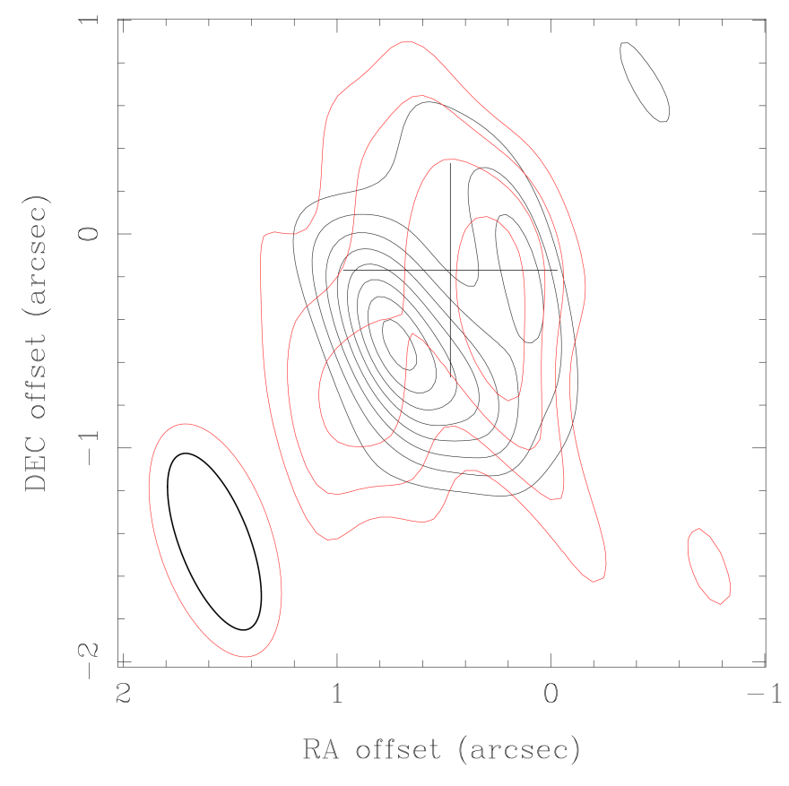
Inner gap/hole (in the dust and gas disk)
: R = 50 AU
FWHM = 0.88”×0.33” (1.3 mm continuum)
FWHM = 1.14”×0.53” (¹³CO line)

Slide 13
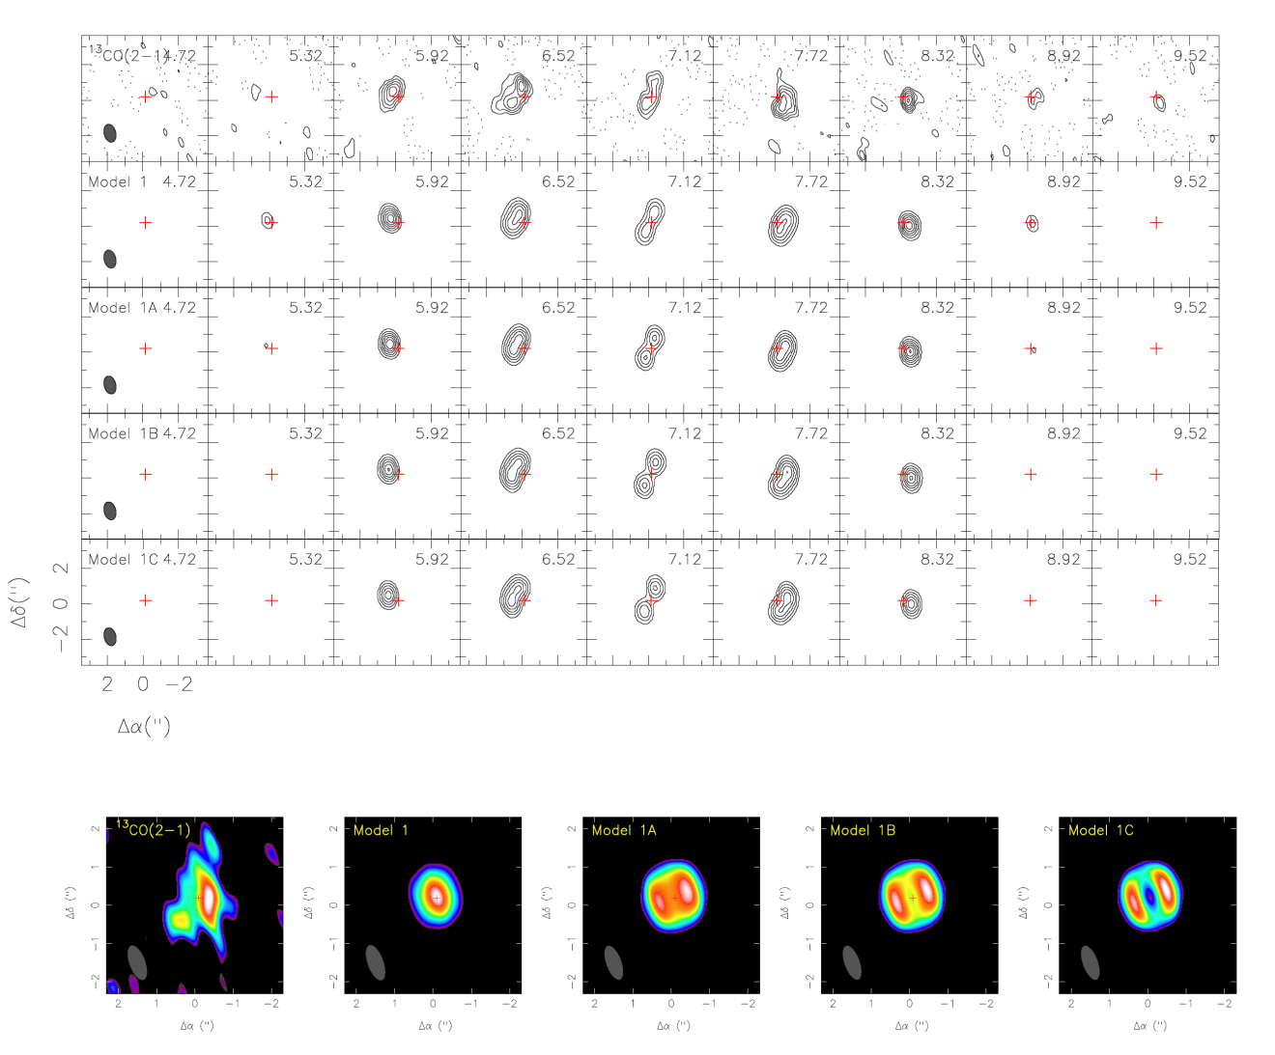

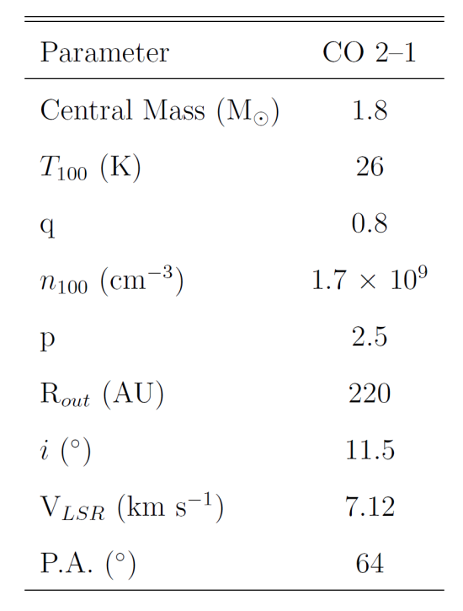
4.3. Modeling of the gas and dust disk
4.3. 1. ¹³CO emission
density depletion ~ a factor of 10 – 20 within 50 AU radius
Monte-Carlo radiative transfer code RATRAN (Hogerheijde & van der Tak 2000)

Slide 14
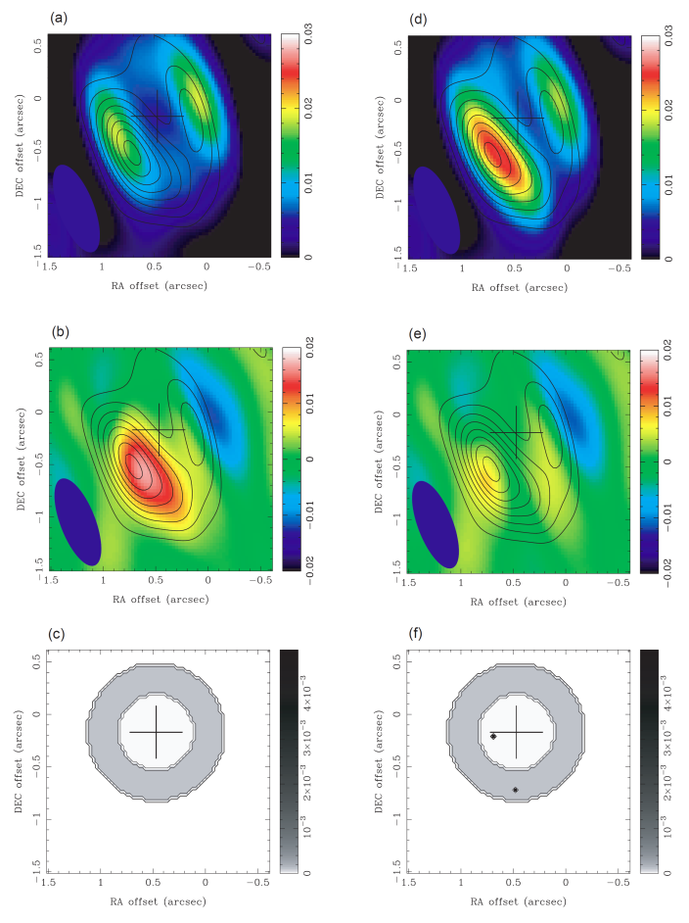
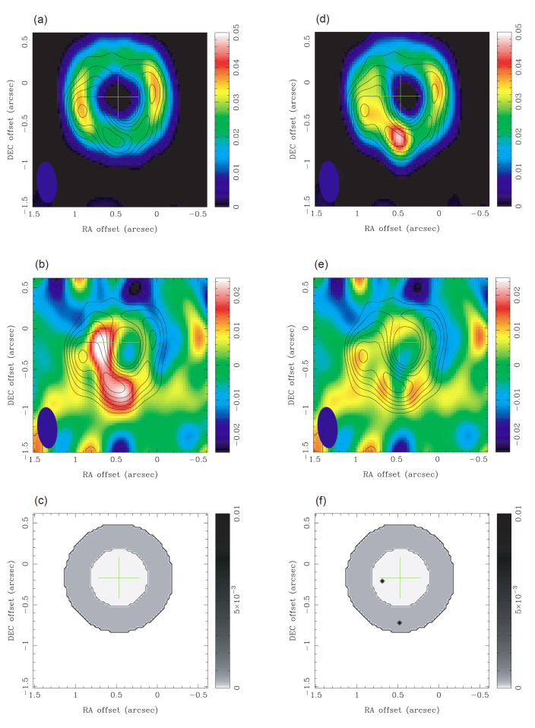
4.3.2. 1.3 mm continuum emission
density depletion : a factor of ~15 within 50 AU radius
significant asymmetric feature in the south-east
: the additional two point sources can account for the observed
asymmetries within the noise
230 GHz
345 GHz
: data from Brown et al. 2009

Slide 15
Near- and mid-infrared (GMT)
: detection possibility of hot young planets near and within the disk
(Sub)-millimeter
: inner hole, disk structure, dust properties
Infrared + (Sub)-millimeter
: disk-planet interaction

